Slide 1
Workforce Competencies in Supporting People with LD and Forensic Histories
Foundation Training

Slide 2
Timings | Item
09:00 | Registration and Refreshments
09:20 | Welcome
09:30 | Contextualising Challenging and Forensic Behaviours
10:15 | Sexual Offending – Assessment and Intervention
11:15 | Refreshments Break
11:30 | Violence – Assessment and Intervention
12:15 | Fire Setting – Assessment and Intervention
13:00 | Lunch & Networking
14:00 | Quality of Life Tools and Measures
15:20 | Overview of the Bradley Report and Other Relevant Policies
16:00 | Close

Slide 3
Service Users Journey – My Story
Part 1
https://vimeo.com/335814266/8673ba3b71

Slide 4
Contextualise Challenging and Offending Behaviours

Slide 5
What Defines Challenging Behaviour
“Culturally abnormal behaviour(s) of such an intensity, frequency or duration that the physical safety of the person or others is likely to be placed in serious jeopardy, or behaviour which is likely to seriously limit use of, or result in the person being denied access to, ordinary community facilities”
Eric Emerson 2011
Notes:
https://www.mentalhealth.org.uk/learning-disabilities/a-to-z/c/challenging-behaviour

Slide 6
Between 5-15% of people with learning disabilities show behaviours which present a significant challenge for those caring for them
Many forms of challenging behaviour are thought of as being functional and adaptive responses to challenging situations, in that they serve as a method of communication with the people with whom they interact (e.g. stopping unwanted attention, attracting attention or attempting to explain they are experiencing pain).
Some forms of challenging behaviour may be linked to mental health problems, such as depression.
Notes:
Such behaviours may include aggression, destructive behaviours or self-injury. People with specific syndromes (for example, Lesch-Nyhan syndrome, Rett syndrome or Cornelia de Lange syndrome), people with more severe disabilities, and those with additional disabilities such as sensory impairments and communication disorders are more likely to demonstrate challenging behaviour.
https://www.mentalhealth.org.uk/learning-disabilities/a-to-z/c/challenging-behaviour

Slide 7
Early identification of the emergence of behaviour that challenges
Personal factors, such as:
A severe learning disability
Autism
Dementia
Communication difficulties (expressive and receptive)
Visual impairment (which may lead to increased self-injury and stereotypy)
Physical health problems
Variations with age (peaking in the teens and twenties)
Environmental factors, such as:
Abusive or restrictive social environments
Environments with little or too much sensory stimulation and those with low engagement levels (for example, little interaction with staff)
Developmentally inappropriate environments (for example, a curriculum that makes too many demands on a child or young person)
Environments where disrespectful social relationships and poor communication are typical or where staff do not have the capacity or resources to respond to people's needs
Changes to the person's environment (for example, significant staff changes or moving to a new care setting).
Notes:
https://www.nice.org.uk/guidance/ng11/chapter/introduction

Slide 8
Getting Help
The most important element in the reduction of challenging behaviour is a thorough assessment, used to find out the function of the behaviour (usually called a functional assessment or analysis).
Once the reason for the behaviour is identified, the intervention can be designed. The most commonly-used approach is positive behavioural support, which has a focus on building new skills alongside reducing less desirable behaviours.
Notes:
https://www.mentalhealth.org.uk/learning-disabilities/a-to-z/c/challenging-behaviour

Slide 9
Adults presenting with challenging behaviours should be supported by the local ‘Community Team for People with Learning Disabilities’ (CTLD), who will undertake the functional assessment and design an appropriate intervention.
Children should be referred to the local Child and Adolescent Mental Health Service (CAMHS) who may have a specialist learning disability practitioner within the team.
Notes:
https://www.mentalhealth.org.uk/learning-disabilities/a-to-z/c/challenging-behaviour

Slide 10
What Defines Offending Behaviour

Slide 11
Offending or challenging behaviour?
For a criminal offence to have occurred, needs to be evidence of “mens rea”, i.e. “guilty mind”: intention to commit offence, recklessness etc
This renders it as challenging behaviour, less likely to be reported to the police

Slide 12
Group discussion
Arguably – ID agencies do not recognise or report offending – are opportunities for intervention missed?
What factors may stop a member of support staff reporting an assault from one LD service user on another?

Slide 13
Possible reasons…
Unclear about intention?
Previous lack of police response
Fear of being blamed / investigated
Unreliable witnesses
Protecting vulnerable individuals?
Challenging behaviour vs offending behaviour
Not wanting to label as “offender”
Worried about breaching confidentiality
ID services often make informal judgements that this is missing, i.e. person did not know the act was illegal, lacked insight into the harm it caused etc (Holland et al, 2003)

Slide 14
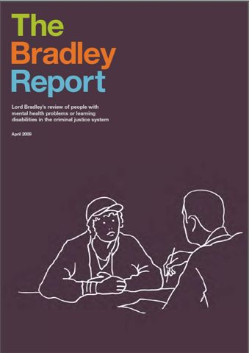
Arrest and prosecution
Bradley report 2009:
  “Mens rea” is difficult for untrained police officers to assess in offenders with MI or LD.
  This could lead to lack of involvement from CJS
  We’ll come back to this report later…

Slide 15
Factors influencing progress through CJS (from Holland et al 2003)

Slide 16
Service Users Journey – My Story
Part 2
https://vimeo.com/339323984/65d4aef81f

Slide 17
The next section will focus on assessment and intervention for
Sexual Offending

Slide 18
Defining sexual offending
“Sexual behaviour perpetrated either without the victim’s consent, or with a victim who is defined as not able to consent” (Murphy, 2007)
Consent is the key issue, i.e.:
  Whether or not consent is given
  Whether the person is able to give consent

Slide 19
Prevalence of sexual offending by people with LD
Estimates vary
Mostly male, co morbid MH problems
Possible increase since de-institutionalisation?
No data on female LD offenders
Underreported?

Slide 20
Commonalities of Sexual Offenders
Frequently from a large family
Exposed to deviant and criminal behaviour
Abused physically or sexually, and neglected (although only around 10 – 20% of victims go on to become abusers)
Conditioning
Poor Attachments , deficits in intimacy and loneliness
Empathy deficits
Low self esteem
Cognitive distortions
Notes:
Use of flip chart stand as a visual interpretation for the above

Slide 21
Wolf’s 1998 model
“vicious cycle” of abuse
Feelings of guilt
Poor self esteem
& negative self image
Expecting rejection – withdraws & isolate self
Deviant sexual fantasises
Justifies deviant
sexual fantasises
Planning &
Targeting
Potential
victim
Grooming to gain
Victim’s trust & use of
Distorted thinking
Brief period of
sexual
Satisfaction

Slide 22
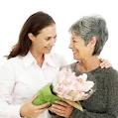






How we adapt Good Lives Model for LD offenders:
Learning new things
Being creative / Making things
Relationships
Enjoying activities that you are good at
Feeling in control of what happens to you
Feeling Calm/Stress Free
Healthy Living
Spirituality

Slide 23
Which risk assessment tools should be used with PWLD with a history of sexual offending?
Notes:
Is this being used as a Group Exercise?

Slide 24
What treatments are effective with sex offenders with LD?
Insufficient evidence to conclude that CBT is an empirically validated treatment, although promising evidence base (Verenooghe and Langdon, 2013)
Labour intensive: may need 1:1 support in groups
Tailored to needs of the individual/s – language, presentation etc
Repetition, slower pace
Build confidence in use of skills before tackling offence-related treatment needs

Slide 25
Sex Offender Treatment Programme - SOTP
SOTSEC – ID – group of therapists who have developed manualised treatment, adapted from Prison service adapted SOTP
Research project: Analysis of Pre and post scores on self report attitude scales, and recidivism rates for 46 men going through treatment
Significant improvement in offence supporting attitudes, victim empathy and sexual knowledge post group and at 6 month follow up
Low recidivism rate at 1 year follow up.
  see SOTSEC-ID (2010)

Slide 26
Kent Partnership Adapted Sex Offender Treatment Programme – KPA SOTP
50 week group
Based around SOTSEC ID and adapted prison / probation model
CBT based, adapted for LD
Group of facilitators – led by qualified, experienced psychologists
Modular program, focussed on:
  Sex education, relationships and the law
  Cognitive model applied to sex offending
  Offending cycles
  Victim Empathy
  Relapse prevention

Slide 27
Steps to offending
Finkelhor model of sex offending (see handout) was simplified to “steps to offending” for use with relapse prevention plans:
Thinking not OK sexy thoughts
4. Offending
3. Planning to offend
  2. Lying to self
1. Thinking not OK sexy thoughts
Notes:
Presenter to talk through the Finkelhor model and advise available via handout

Slide 28
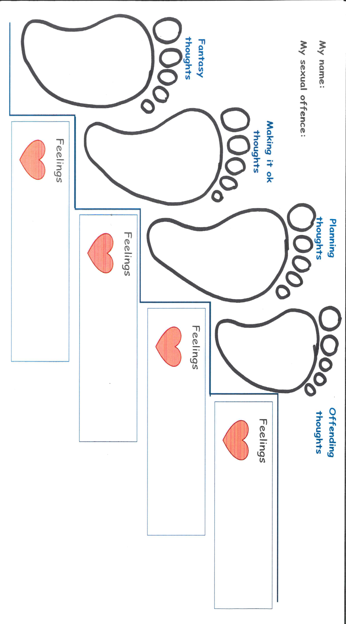

Slide 29
Group exercise
  Get into groups of 2-4
  Complete a four-stage model assessment of one of your own “risky” behaviours
  Use a non-offending example to , such as smoking, spending too much money, or taking someone else’s chocolate. Focus on:
    Fantasies about your risky behaviour,
    The lies you tell your self to make it OK,
    How you “accidentally” plan to engage in your risky behaviour!

Slide 30
Case Study – Mr A
Referred to LD services as he was living in a residential service and wanted to move on into a supported living placement
Under investigation for alleged inappropriate sexual behaviour towards a younger brother
Additional concerns about contact he had had with other vulnerable people with LD that he had approached in a community football group, a disco and college.
This had occurred in both in previous placement and in his existing placement.
As a consequence there were bail conditions that had to be adhered to which included no access to the internet, mobile phones, camera’s and no contact with minors expect in everyday usual situations.
DoLs placed restrictions on Mr A around managing his finances and supervision when accessing the community
Considerations of assessment - social interaction skills and money management with the restrictions placed upon him
Court action found Mr A guilty of sexual offences
Found to have groomed 6 girls aged between 9-15 via Facebook using multiple profiles, befriending them by suggesting that they play a game, asking them to swop pictures of themselves, offering between £200- £5000 pounds for images of their private parts
occurred over a 3 month period when he was under the care of residential services

Slide 31
The next section will focus on assessment and intervention for
Violence

Slide 32
Group Discussion
How would you define violence?

Slide 33
What is Violence?
  Behaviour which is obviously likely to cause harm to others
  Threats of harm: must be clear and unambiguous – i.e. “I’m going to kill you!”
  Fear inducing behaviour (e.g. stalking)
Intention to harm, or harm to the victim, is not he defining feature, but the act itself.
Acts that result in criminal or civil sanctions

Slide 34
What is violence?
Including (not exhaustive):
Hitting,
Punching
Kicking,
Biting,
Scratching,
Use of weapons,
Sexual violence
Less clear acts of violence:
Harming animals
Verbal abuse with no threats of violence,
Property damage with no harm to others,
Acts of self defence.

Slide 35
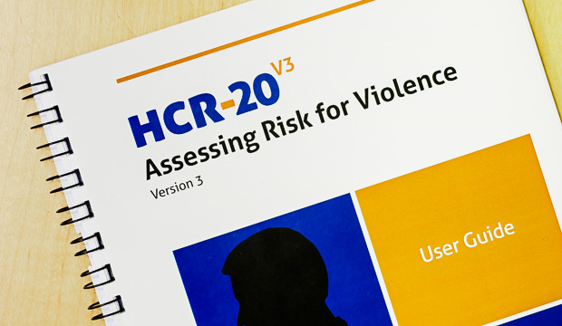
HCR-20
Violence risk assessment, very reliable predictor of violence in mainstream and LD populations
DOH 2007 Best Practice in Managing Risk guidance identifies it as a “tool for supporting best Practice”
Royal College of Psychiatrists describe it as “probably the only defensible approach to risk assessment and management” (O Grady, 2007)

Slide 36

Decision Theory of Violence
Viable Response Option – ‘People choose to be violent’. Always violent for a reason/purpose.
Potential Reward or Benefit
Acceptable Cost
Feasible

Slide 37
Motivators for Violence
What was the person trying to accomplish?
Which factors increased the perceived gains or benefits of violence?

Slide 38
Control / Change
Status / Esteem
Gain /
Profit
Release / Expression
Justice / Honour
Arousal / Activity
Defence / Distance
Proximity / Affiliation
PERCEIVED REWARD

Slide 39
Disinihibitors for Violence
Most people understand that violence towards others causes harm and has negative consequences for self and others – how to violent offenders overcome this?
Which factors decreased the perceived costs or negative consequences of violence?

Slide 40
Nihilism
Lack of Insight or Awareness
Alienation
Negative Self-concept
Lack of Guilt or Anxiety
Negative Attitudes
PERCEIVED COST
Lack of Empathy

Slide 41
Destabilisers for Violence
Did the person have problems thinking clearly and forming plans?
Which factors impaired, disturbed, or disrupted the person’s decision making?

Slide 42
Impaired Problem Solving
Impaired Reasoning
Disturbed Perception
Racing Thoughts
Perseverative Thoughts
Disturbed Attention
CAREFUL DECISIONS

Slide 43
What psychological treatment would we offer for violence?
Could still use PBS approaches
Adapted CBT based treatment programmes
  Anger management
  Specific programmes (Life Minus Violence in forensic settings)
  Thinking Skills (Reasoning and Rehabilitation )
  EQUIP

Slide 44
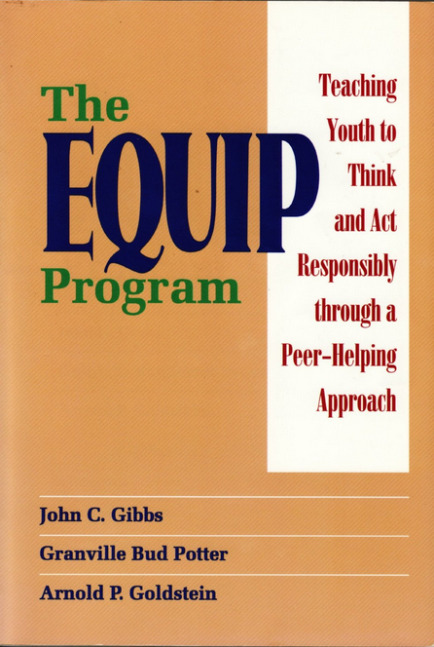
Four different types of sessions:
  “Equipment” meetings – anger management (cognitive restructuring, relaxation training, imagery), social skills training (active role play), social decision making.
  “Mutual Help” meetings – active problem solving using the techniques learned during equipment meetings.
  Recent research project evaluating an adapted version for people with LD

Slide 45
    Four thinking errors
Being Self Centred
Thinking the Worst
“I just want to have a good time, what’s so bad about that?!”
“I didn’t really hurt him or her anyway!”
“I can do what I want!”
“No one can tell me what to do!”
“Why bother? It never works out for me!”
“I never do anything right!”
“I got mixed up with the wrong crowd!”
“He was asking for it!”
Playing down harm
Blaming Others

Slide 46

A Martian wants to move to another planet….

Slide 47





Planet A or B?
A
Violent, people hurt each other
B
Safe, peaceful, people work together

Slide 48
Case Study – Mr B
22 Years Old, diagnosis of mild LD, Autism and possible Epilepsy
Residing in an LD low secure hospital as an inpatient for 3 years, under section 3 of the MHA
Admitted after ongoing concerns of threats of violence using a knife and letters of intent to kill towards various family members
Struggled with managing his emotions and would present with grandiose ideas and ‘violent outbursts’
Described as being ‘settled’ and getting on well with peers and staff on the ward
Plan to discharge under a Community Treatment Order (CTO)
Would benefit from a predictable routine and meaningful occupation
Potential provider identified who could provide placement living alongside two other males, in a shared house over three floors that would allow Mr B to have his own bedroom, bathroom and sitting room on the third floor of the premises
Support required for the transition into a community placement and support for the provider to source appropriate and meaningful activities within the home and wider community settings

Slide 49
Questions?
How would you proceed with this referral and gather the initial information you require to inform your assessment and intervention? (who/where might you go to find this out)
Which therapy models and assessment tools would you use and why?
What areas of risk do you think you would need to explore?
What considerations would you give to a risk management plan?

Slide 50
The next section will focus on assessment and intervention for
Fire Setting

Slide 51
Legal definition of fire setting
Intentional destruction of property—via fire—for unlawful purposes
(Kolko, 2002; Williams, 2005)

Slide 52
Who sets fires?
Generally Males: Ratio of Male to Female = 6:1
      (Bourget & Bradford, 1989; Stewart, 1991)
Generally Low SES:
  Unskilled Employment
Low School Achievement
(Doley, 2003; Ritchie & Huff, 1999)
Impoverished Backgrounds:
  Neglectful Parenting, Physical/Sexual Abuse
Financial Hardship
(Bradford, 1982; Slavkin, 2000; Showers & Pickrell,1987)

Slide 53
ID fire setters
Studies suggest firesetting is over-represented in ID offenders, although studies reviewed show rates varying from from 11-15%, to 3%. Tend to bypass criminal justice system (Lindsay and Macleod,2001; Depraviam et al , 2007)
Other studies suggest fire setters make up one fifth of referrals to forensic ID services (Taylor et al, 2002; Barron et al 2004), ID more prevalent in multiple fire setters (Dickens et al, 2009)
Most common motivation revenge, suggestibility
Over prevalence of PD diagnosis, early maladjustment, substance misuse

Slide 54
Group Discussion
Why do people set fires?

Slide 55
Why do people set fires?
  Pyromania?
    Research shows very few fire setters meet the diagnostic criteria
Modelling from others?
Displaced anger?
  Communicating distress?
    Yes, but one factor is not enough to explain this complex problem
Multi factor models more useful
  i.e. Only Viable Option (OVO) model; MTAFF (see handout)
Notes:
Presenter to refer to handout for the next slide

Slide 56
Factors associated with fire setting
Social isolation
Communication difficulties
Lack of assertiveness
Problems regulating emotions, particularly anger and low mood
Low self esteem
Feeling unheard
Anti social attitudes
    Fire interest

Slide 57
Why do people set fires?
To communicate distress
To make people listen
To alleviate anger
To escape a problem situation

Slide 58
LD fire setters
Case study: Young ID male - social isolation, communication difficulties and lack of assertiveness, powerlessness, anger and depression.
Clare, Murphy, Cox & Chaplin (1992) Treatment package focussed on social skills and assertiveness training, follow up at 48 months post treatment revealed no evidence of recidivism.
10 ID fire setters most commonly identified prior emotion were feelings of anger, not being listened to. Anger reduced following fire setting (Murphy and Clare, 1996)

Slide 59
Assessment
  Fire interest rating Scale; Functional analysis of Fire setting, (FIRS and FAS Murphy & Clare, 1996)
  Fire Identification scale (Gannon et al 2010)
  Also focus on:
    Locus of Control
    Fire related behaviour: e.g. excessive fire play as a child, fire interest
    Neglectful / abusive family background

Slide 60
Fire Setting Intervention Program
Adapted from FIP – MO, Developed by Gannon and Lockerbie, 2012.
Modular group:
Group formation (2 sessions)
Understanding my offending (6 sessions)
Fire interest / safety (4 sessions)
Mood and coping (2 sessions)
Communication and relationships (4 sessions)
Mental Health and offending (1 session)
Exploring offence patterns (4 sessions)

Slide 61



STOP THINK DO

Slide 62


Assertiveness

Slide 63
Case Study – Mr C
Mild LD , ASD traits, Anti social attitudes and behaviours. Limited information/ evidence for early maladjustment.
In his 20’s - Placed a lit photograph under the door of the staff sleep in room, and lit tissue paper into gas boiler at his residential home – received a caution.
2012 -arrested and charged following setting a fire in a fellow resident’s bedroom on the mattress and left the room, shutting the door. He had expressed a dislike for the other resident, and had made allegations against him He had secreted a lighter.
Other behaviours included loosening handlebars on another resident’s bicycle, and throwing a heavy glass ashtray at others. Theft from staff and work placements, animal cruelty, property damage.
Lacks insight into the risk he presents towards others. Displays attitudes which support the use of fire setting
Significant difficulties with interpersonal interactions, problem-solving skills, impulse control and thinking trough the consequences of his actions.
Strong “grievance” thinking style, used fire setting as a problem solving tool, to express anger and frustration
Placed on probation order, attended fire setting treatment group.

Slide 64
RISKY SITUATION:
Relationships with staff broke down.
RISKY FEELINGS:
Angry/ fed up
My KEEPING SAFE PLAN:
I am not going to do it again
Never have a lighter.
Relax and manage my anger
Talk to staff when I feel angry with them
Family “too busy”
Staff “too busy”
didn't want to listen
SAFE THOUGHTS:
Family and staff do care.
It is NOT OK to be aggressive
I do care about other people. I don’t want to hurt people.
RISKY THOUGHTS:
No-one cares
Sometimes it’s ok to be
aggressive.
Staff think I don’t care, but I do! This will make them listen.
Fire is powerful
REMEMBER:
Fire is dangerous
It hurts people and things
I wont get a second chance
I don’t want to go back to court
Staff do listen.
Hide a lighter, Set fire to clothes in my room.

Slide 65
10 Principles of Violence Risk Management (Maden, 2007)
Risk Management
Violence is our business.
There is no alternative to violence risk management.
Good violence risk management is good for patients.
Hope for the best BUT plan for the worst!
Prediction is impossible, but prevention can be easy.
Not all violent acts are equal.
Standardised assessments help clinicians but don’t replace them.
Aspire to the best but give what you can afford.
Write it down.
When in doubt, treat!
Notes:
Violence is our business: Violence is an important complication of psychosis. i.e. schizophrenia is found in 1% of the general population BUT in 5% of people in the UK charged with murder.
There is no alternative to violence risk management: If you detain people under the MHA (1983) on the grounds of risk to others, you already assess violence risk!
Good violence risk management is good for patients: It is never in the patient’s interests to allow them to commit violence, good risk management can guide and support MDT interventions.
Hope for the best BUT plan for the worst!
Prediction is impossible, but prevention can be easy: The HCR-20 is not about numbers or classifications of likelihood of violence, it should be used as a framework for prevention of violence.
Not all violent acts are equal: Need to distinguish between violence due to mental illness and violence for other reasons (e.g. anti-social attitudes, substance use, personality).
Standardised assessments help clinicians but don’t replace them: Important to use mixture of actuarial measures and clinical impression. Best to consider risk within structured framework (e.g. HCR-20). Very important to discuss and consult with colleagues.
Aspire to the best but give what you can afford: Should decide on safest risk management then worry about how and whether it is possible to provide the treatment. If the HCR-20 says do X and you can’t. Document the UNMET need.
Write it down: Risk assessment and management plans should be documented and understandable to other professionals. If it’s not, then this needs to be addressed.
When in doubt, treat: It is easier to defend a decision to try than not to try…

Slide 66
Violence Risk Management
Consider short, middle & long term (community) plan.
Consider maintenance, relapse or crises plans.
Consider Monitoring:
- What is the best way to monitor warning signs that the risks posed by the perpetrator may be increasing?
- What events, occurrences, or circumstances should trigger a re-assessment of risk?
Consider Treatment:
- What treatment or rehabilitation strategies could be implemented to manage the risks posed by the perpetrator?
- Which deficits are high priorities for interventions?

Slide 67
Violence Risk Management
Consider Supervision:
- What supervision or surveillance strategies could be implemented to manage the risks posed?
- What restrictions on activity, movement, association, or communication are indicated?
Consider Victim Safety Planning:
- What steps could be taken to enhance the security of the victim?
- Improvements to victim’s physical security/self-protective skills?
Other Considerations:
- What events/occurrences or circumstances might increase/decrease risk?
- What else might be done to manage risk?

Slide 68
Group discussion task
How might risk management differ between “mainstream” offenders and those with LD?
What are the particular challenges?

Slide 69
Risk management in LD
More focus on external factors:
  Staff supervision
  Staff awareness of risk history
  Robust boundaries
  Structured activity
  High levels of support
  Geographical location of service
  Use of legal frameworks

Slide 70

Hopefully, service users are
compliant with risk management
plans
BUT WHAT IF THEY BECOME
NON COMPLIANT?
HOW DO WE MANAGE RISK AND
PROTECT HUMAN RIGHTS OF POTENTIALLY VULNERABLE PEOPLE?
WE NEED A LEGAL FRAMEWORK

Slide 71
Legal Frameworks
DOLS under MCA
Criminal Justice System
MHA

Slide 72
Deprivation of Liberty Safeguards (DOLS):
apply to people aged 18 or over
suffer from a disorder or disability of mind (e.g. profound LD, dementia, severe autism)
P must lack the capacity to give consent to the arrangements made for their care or treatment,
for whom such care is considered, after an independent assessment, to be a necessary and proportionate response in their best interests to protect them from harm
cover patients in hospitals and people in care homes, whether placed under public or private arrangements

Slide 73
Problems / challenges:
  Deprivation or restriction?
  Designed to protect vulnerable individuals, rather than manage risky individuals (although maybe protecting him from himself? Or retribution from victim / families?)
  Capacity assessments are subjective
  Must be decision specific, so which decisions?
  Only lasts for 6 months
  Need to go to court of protection for long term deprivation
    Complex application process
    Can take 6-12m to be reviewed and agreed
    Expensive and time consuming

Slide 74
Criminal Justice System
MAPPA have strict criteria, normally focussed on severity of offending and previous convictions.
PWLD are often not convicted
Without convictions, hard to secure frameworks such as a sexual harm prevention order (SHPO), SO registration etc

Slide 75
Criminal Justice System (cont)
Sexual Risk Order
  Application to magistrate’s court
  18 and over
  Focuses on offences against children
    Includes sexual communication, “giving a child anything that relates to sexual activity
  2 or more occasions
  Order lasts a fixed period – at least 2 years
  Breach of the order is a punishable offence

Slide 76
Criminal Justice System (cont)
Potentially Dangerous Person (PDP)
A person who is not eligible for management under MAPPA but whose behaviour gives reasonable grounds for believing that there is a present likelihood of them committing an offence or offences that will cause serious harm.
A present likelihood reflects imminence and that the potential event is more likely than not to happen.
Process mirrors MAPPA, police – led.
Regular multi agency review meetings

Slide 77
Mental Health Act
S7 of MHA (1983): Guardianship Order Basic criteria:
  Mental disorder (severe mental impairment included)
  Nature and degree to warrant application
  In the person’s best interest
  Least restrictive option

Slide 78
Guardianship Powers
Require the person to live at a particular place
Require the person to go to specific places at specific times for the purpose of:
  medical treatment
  occupation
  education
  training
Approved person must be given access to the person
Also receive a care co-ordinator, open to CPA process

Slide 79
Valuing people vs managing risk
What if empowerment leads to offending?
Is it not more empowering to
  Offer treatment and support
  Help develop insight into the risk they present to others, and
  Get them to “sign up” to a risk management plan that protects them from re-offending, even if it means restrictions in the short term?
Risk management plans don’t have to be negative…

Slide 80
Quality of Life Tools and Measures

Slide 81
The Health Equalities Framework (HEF)
An outcomes framework based on the determinants of health inequalities, provides a way for all specialist learning disability services to agree and measure outcomes with people with learning disabilities, it can also be used by all services with regard to their effectiveness in tackling health inequalities for people with learning disabilities.

Slide 82
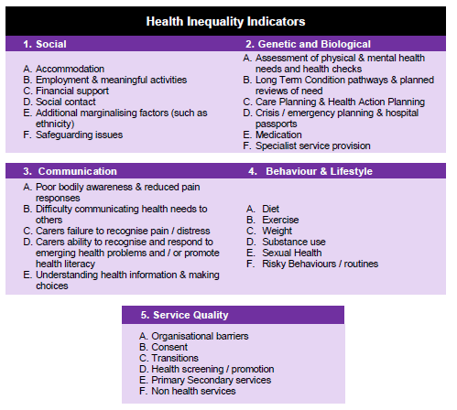

Slide 83
Health of the Nation Outcome Scale - HoNOS
How does HoNOS-secure benefit the service user?
It is about care planning and interventions. The ratings are based on the results of a clinical assessment, and so can be used as a broad check for the multi-disciplinary care plan and risk management plan. A security scale rated at 1 or above indicates that a risk management intervention is needed, and for scales 1 to 12 a rating of 2 or above indicates that a care or treatment intervention is needed. These interventions should already have been identified and included in the care plan / risk management plan as a result of the
clinical assessment.
The completed HoNOS-secure score sheet provides a profile of 19 severity ratings, a total HoNOS score, and a separate security score. It is intended to be an integral part of a minimum data set and a basic component of the Care Programme Approach for users of secure / forensic services

Slide 84
What are the other scales?
1 = Overactive, aggressive, disruptive or agitated behaviour
2 = Non-accidental self-injury
3 = Problem drinking or drug-taking
4 = Cognitive problems
5 = Physical illness or disability problems
6 = Problems with hallucinations and delusions
7 = Problems with depressed mood
8 = Other mental and behavioural problems
9 = Problems with relationships
10 = Problems with activities of daily living
11 = Problems with living conditions
12 = Problems with occupation and activities
What are the security scales?
There are 7 security scales:
A = risk of harm to adults or children
B = risk of self-harm (deliberate or accidental)
C = need for building security to prevent escape
D = need for a safely staffed living environment
E = need for escort on leave (beyond secure perimeter)
F = risk to individual from others
G = need for risk management procedures
How does HoNOS-secure benefit the service user?
It is about care planning and interventions. The ratings are based on the results of a clinical assessment and so can be used as a broad check for the multi-disciplinary care plan and risk management plan.

Slide 85
Overview of Bradley Report and Other Relevant Policies

Slide 86
Bradley Report Overview
2009 This report reviewed people with mental health problems or learning disabilities in the criminal justice system.
The report noted that 64/143 schemes included learning disability workers. Despite Reed’s report (1992) that recommended schemes should develop effective links with local LD teams, and where possible teams should be encouraged to contribute to schemes.
All police custody suites should have access to liaison and diversion services.
Clear mandate that learning disabilities and mental health problems are identified.

Slide 87
Bradley report 2009: review of people with mental health problems or LD in CJS
Early intervention, arrest & prosecution (awareness training, early intervention in communities, improving AA service, screening for LD at police station, NHS to run police health services, signposting to health & social care, conditional cautions, diversion++)
The court process (vulnerable witness procedures to be extended, bail not remand in custody, LD training, SLAs for psychology reports, specialist courts)
Prison, community sentences, resettlement (more CROs with treatment conditions, LD screening in prison, in-reach teams, CPAs, NOMS & NHS plan for rehab on leaving prison; mentoring for people leaving prison)
Delivering change thru partnership – National Programme Board with National Advisory Group, local Criminal Justice Mental Health Teams, role of PCTs

Slide 88
Impact of Bradley et al
Has had some impact:
  Police Custody Liaison and Diversion Service (PCLADS)
  Operated by KMPT, CPNs in police stations across East Kent (though more MH than LD)
  Mental health magistrates court

Slide 89
Recommendations
All agencies should adopt a shared definition of LD
Ensure LD is considered when making decisions on charging / prosecution
Police should make screening tools available / improve AA / custody suites
More effective signposting into services
Ensure risk of harm is also assessed – impacts on eligibility for treatment
(e.g. Dennis Gill vs secretary of State for justice 2010)

Slide 90

Positive Practice, Positive Outcomes: A Handbook for Professionals in the Criminal Justice System Working with Offenders with a Learning Disability
http://www.dh.gov.uk/en/Publicationsandstatistics/Publications/PublicationsPolicyAndGuidance/DH_124743

Slide 91
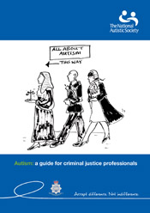
Autism – A Guide for Criminal Justice Professionals
http://www.autism.org.uk/cjs

Slide 92
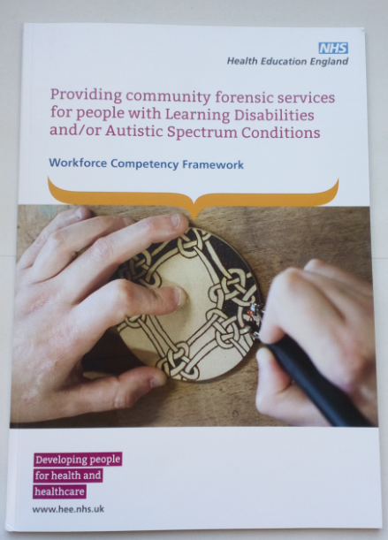
HEE – Workforce Competency Framework
Providing community forensic services for people with Learning Disabilities and/or Autistic Spectrum Conditions
For use by:
Commissioners of Services
Health Service Providers
Social Care Service Providers
Education and Training Providers

Slide 93
Service Users Journey – My Story
Part 3
https://vimeo.com/339324077/e98a5f7d0c

Slide 94
Top Tips! general guidance for support staff
Be Aware and open about risk:
  Know your client’s risk history
  Risks increase whilst out in the community
  Be vigilant – grooming behaviour can be very subtle!
  Make them aware that you’ll be looking out for risky behaviour, and that you can support them
  When safe to do so, offer a discussion about the inappropriate nature of their behaviour, and also offer praise for any use of relapse prevention strategies as a result of your intervention.

Slide 95
Top Tips! general guidance for support staff
  Be realistic – there is no “cure” for deviant sexual arousal, this is a lifelong issue
  Separate the person from the act – good people can do bad things.
  Don’t demonise, try to understand why
  Hold your Boundaries :
    not a personal relationship, but a professional one
    Don’t disclose excessive personal information – i.e. your intimate relationships, children
    Be respectful and validating, focus on the person and how they are feeling
    Remain neutral, don’t feed into grievances or “splitting” – i.e. attempts to play staff off each other.
    Avoid getting too close – “I’m the only one they can talk to….we have a special relationship” - this can lead to dependency and disempowerment
    Consistent messages from all staff are important in managing risky behaviour

Slide 96

Top tips! general guidance for support staff
Record any risky behaviour on appropriate incident forms
These reports will feed into discussions with the men either individually or in group-work
Better to over record than under record
Also record good coping as a strength

Slide 97
Protective factors
May reduce the likelihood of future offending:
  Engagement with activities / occupation
  Positive response to treatment
  Positive relationships and role models
  Abstinence from substances
  Positive attitudes
  Engagement with professionals
  Life goals

