Slide 1
Young Carers and Covid
Minimizing impact and Maximizing outcomes
Rebecca Rolfe Service Manager
The Children’s Society Include Service

Slide 2
Context: Legal definitions and rights
Impacts
Response : Education
Response : Health
Covid : Lived experience of lockdown
Covid : Living in a Covid world
The future

Slide 3
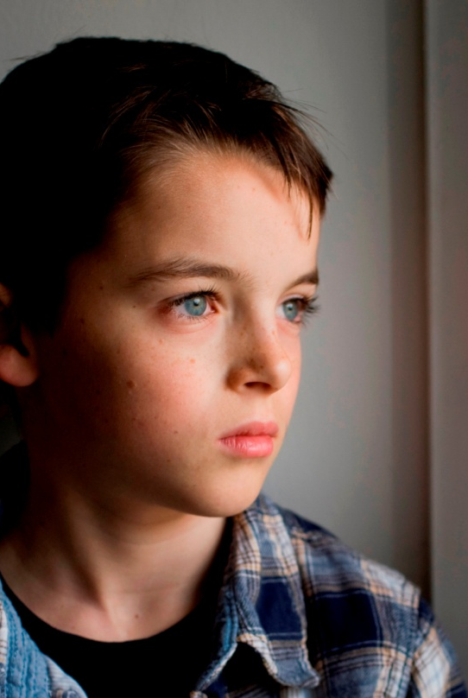
Young Carers -Definition
Children and Families Act 2014 Section 96
“…a person under 18 who provides or intends to provide care for another person (of any age, except where that care is provided for payment, pursuant to a contract or as voluntary work).”
Up to 800,000 young carers in the UK. That’s up to 1 in 5 in the classroom.
Notes:
A young carer becomes vulnerable when the level of care provide has a negative impact on their own emotional or physical health, education, leisure time and future life chances.

Slide 4
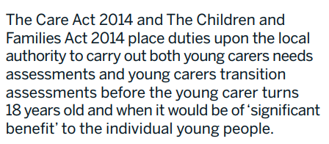
Entitled to Assessment of Need & Transition Assessment
If a child is caring then there is an unmet need.

Slide 5
What do young carers do?
Physical care such as lifting, helping a parent on stairs, physiotherapy.
Practical tasks such as cooking, housework, shopping.
Personal care such as dressing, washing, helping with toileting needs. Giving medication.
Managing the family budget, collecting benefits and prescriptions.
Looking after younger siblings.
Emotional support.
Interpreting.

Slide 6
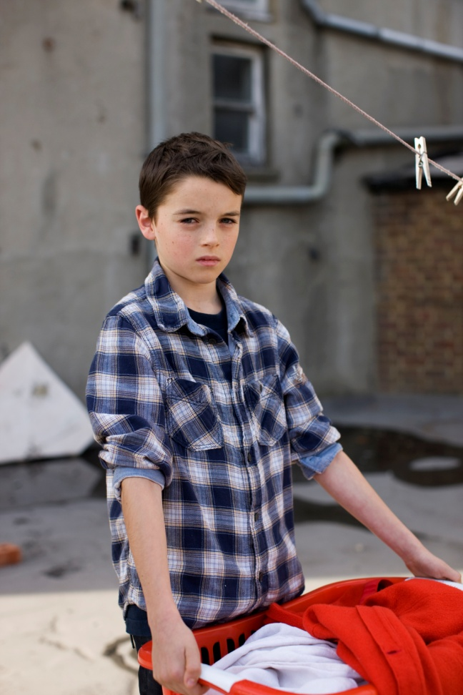
Impacts
On young carers living in the UK.
Physical injury/illness/developmental
Emotional – anxiety/behaviour problems/mental ill health
Worry
Social – isolation/bullying
Educational – attendance and achievement
Future life chances
Increased risk of CE & CSE
Notes:
Link back to the statistical impacts outlined in the stats report. – what does this refer to?
How is the health and well-being of young carers affected?
Physical – Those caring for parents/siblings with a physical illness are more likely to suffer with a physical illness themselves, back injury, aches etc
Emotional – those caring for a person with a mental illness are more likely to suffer emotional problems, behavioural probs etc themselves.
Also, effects of poor diet, lack of sleep etc. Missed doctors and dentists appts.
Many YC also have emotional problems into adulthood, the effects of bullying, difficulties establishing relationships.

Slide 7
Young Carers and School

Slide 8
Impact of being a Young Carer
Evidence shows that being a young carer can impact on attendance, attainment, personal development and welfare:
Over ¼ miss school regularly
Significantly lower educational attainment at GCSE level – an average one grade lower across all subjects.
On average young carers miss or cut short 48 school days a year
62% said they were bullied
42% say there is not a particular person at school who recognised them as a carer

Slide 9
Young Carers in Schools
The Award

Slide 10
Created and developed by Young Carers Five key actions
Schools
Understand – is there a young carer lead to approach
Inform – raising awareness though both staff and students to reduce stigma
Identify- can staff recognise indicators and action next steps
Listen- space to talk, or just rest
Support- practical intervention, space to call home, homework support during school day, signposting/ referring to local Young Carers Service or EH or for assessments if necessary

Slide 11
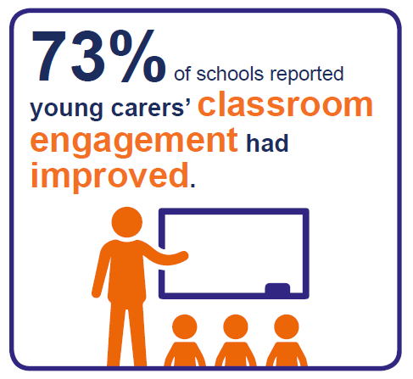
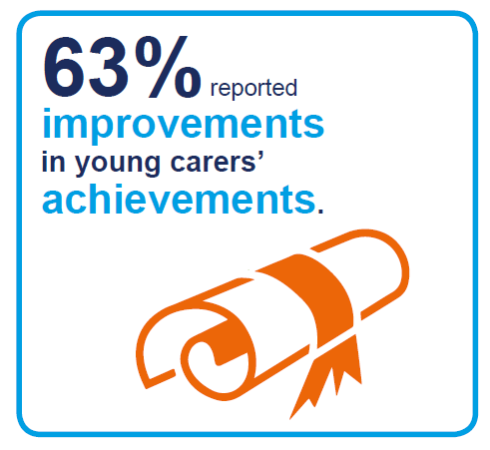
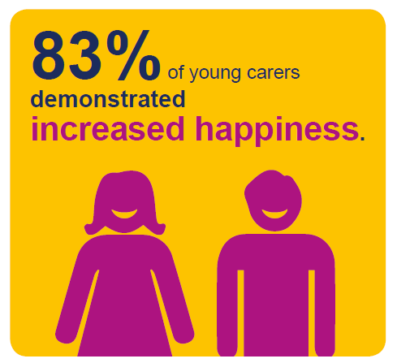
The Impact of YCiS Award

Slide 12
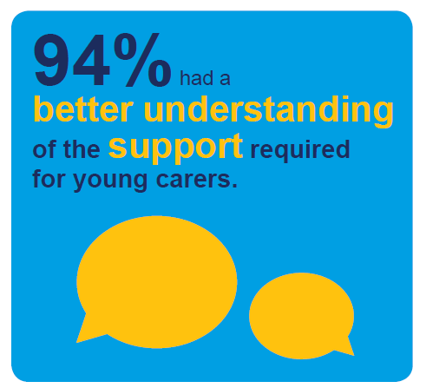
The Impact of YCiS Award
“The Young Carers in Schools Programme has enabled us to ensure that the right support is in place fro young carers. We are now more aware and more able to address their needs”
Head teacher

Slide 13
Health services are ideally positioned to identify young carers. If a professional can spot where extra support is needed, they can prevent potential long term harm.
Some of the health risks facing young carers include:
Becoming ill or suffering an injury when lifting or dressing someone
Developing emotional problems
Developing symptoms of an eating disorder
School Nurses play an important role in identifying and working with young carers in school. Here are a list of trainings and resources to help school nurses do this effectively:
School Nurse Pathway — designed to guide school nurses to the right support for young carers
School Nurse Website - explanation of who young carers are and what school nurses can do to support them.
NHS Carers Toolkit — covers duties on NHS organisations brought about by the Care Act 2014 and the Children and Families Act 2014.
Queens Nursing Institute carers Resource Project — The QNI has developed three free online resources to support nurses who work with carers. One specifically developed for Nurses working in General Practice, one specifically for School Nurses and one for Community Nurses to enable effective identification.
Supporting Carers in General Practice — a module created to provide information and guidance for healthcare professionals to enable them to build carer involvement and support into their everyday practice.

Slide 14
NHS England and its partners have developed a toolkit to help health and social care organisations work together in identifying, assessing and supporting the well-being of carers and their families.
Our GP and Health Professionals Pack contains a guide for supporting, identifying and signposting young carers, posters for the waiting room and staffroom, and a booklet for young carers.
Other useful resources:
Young Carers: Information for healthcare professionals
Supporting Young Carers and their Families

Slide 15
Supporting, identifying and signposting young carers in your adult departments:
How can you identify through your practice situations and families where there might be young carers? Ask the following questions:
Who helps to care for the person at home?
What effect does their condition and personal care needs have on the family?
Is there a child/young person in the family who helps to provide care?
How does this affect the child/young person physically, emotionally or educationally?
Is there any direct help that would support the young carer?
Does the parent need support in their parenting role?
What can be offered to help the whole family?
When prescribing medication for your client, consider whether a young carer may be administering it? Is this appropriate? Do they need support?

Slide 16
Young Carer Lead Professionals Lockdown Experience
‘Some (YC) said that their family are more reliant on them so much now. Struggling to catch up on school work and the isolation and stress of the situation.’
‘It is hard for YC to admit that they’re struggling when they come back to school.’
‘some don’t want their child to be identified as a young carer’
‘we have spoken to the parents, the feedback is not necessarily the same as what the child would say if we could speak to them on their own’
‘…hidden YCs who are not on anyone’s radar, the (mental) illness could have been exasperated.’
‘Yr11’s have confessed that they feel robbed from everything including exams, proms, transition to college…They are a very fragile group of people.’
‘Managing the young people’s emotions, it’s 90% of the conversations
we have, and it is hard to read body signals when it’s over the phone’
‘We are worried about the YC becoming school refusers.’

Slide 17
https://www.channel4.com/news/young-carers-say-lockdown-has-affected-their-mental-health

Slide 18
Young Carers experience of lockdown
67% of young carers are more worried about the future since coronavirus
66% of young carers are feeling more stressed
59% of young adult carers say their mental health is worse
52% of young adult carers feel overwhelmed by the pressures they are facing now
Carers Trust 2020 https://carers.org/

Slide 19
Response to Covid 19
Covid Recovery Kit
In collaboration with Carers Trust.
Includes:
Staff briefing PowerPoint presentation. Simple no nonsense 6 slides
Top tips 2 sided – great poster guide
https://youngcarersinschools.com/covid-19/
In addition: Sheffield Young Carers plus 11 other YC Services bought together a panel of young carers.
‘Top Tips’
‘Young Carers Identification Guide’

Slide 20
Indicators:
Late or missing days or weeks off school for no reason, or struggling to complete homework
Often tired, anxious or withdrawn
Having problems socially, and may get on better with adults displaying mature behaviour
A victim of bullying. This is sometimes explicitly linked to a family member’s disability, health or substance misuse problem.
Depressed
Finding it difficult to concentrate
Having difficulty in joining in extra-curricular activities or hobbies
Isolated because of their family situation or because they lack social skills with their peers (and yet they are confident with adults)
Anxious or concerned about an ill or disabled relative
Displaying behavioural problems
Having physical problems such as back pain (perhaps from heavy lifting)
Secretive about home life
Showing signs of physical neglect or poor diet
Child in Need, Child Protection plan, or CLA, where parental ill health or addiction issues are involved

Slide 21
See Hear Respond
Children and young people will get help in one or more of four ways:
an online hub of support and information,
online counselling and therapy,
face-to-face support for those most affected and at risk, and
helping children and young people reintegrate back into school
Offering mental health and well-being and reintegration into education.
One -2 one or group sessions

Slide 22
Further information:
https://www.childrenssociety.org.uk/youngcarer/home
https://youngcarersinschools.com/covid-19/
Email: YCiS@childrenssociety.org.uk
Rebecca.Rolfe@childrenssociety.org.uk
Michelle.Gregory@childrenssociety.org.uk
SHR referrals:Refer any child you are worried about, and who is not already supported by a statutory agency. You can call 0800 157 7015 to make a referral from 9am to 9pm Monday to Friday, and 10am – 6pm at weekends, or go to barnardos.org.uk/see-hear-respond to use our secure referral form.

